Slide 1
HFNY Accreditation
Supporting Selected Sites
Notes:
Session will be recorded and uploaded to the HFNY website
We’ll leave time for questions at the end of this session but please feel free to put questions in the chat as we go along, and we’ll work to answer all of them at the end.

Slide 2
Today’s agenda
What to expect for support from your CA Partners
Self Study Re-submission
Prior to On Site Visit
Logistics of Peer Reviewers Visiting
What's Next
Notes:
Here is the agenda for today.

Slide 3
What supports are available for sites selected?
Bi-Weekly-Monthly webinars to share information and answer questions
Updated data chart with individualized information for pulling MIS reports
Accreditation tool
Accreditation Prep Guide
Review Self Study to ensure all elements are included
Documentation Review and feedback prior to onsite visit

Slide 4
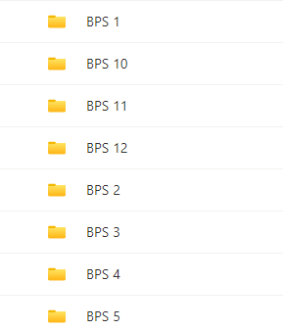
Self Study Reorganization of folders
Notes:
We have reorganized folders in the SharePoint to reflect the folders by BPS. This is a requirement for the peer reviewers to review the self study. It also helps to organize things in such a way that makes reviewing more efficient for the peers. The less digging they need to do to find things, the better it is. This helps to ensure that every BPS that is required for the self study is included. Please refer to the folders that have been created for you to guide your uploads as well as the accreditation tool. Leave the other folders that are there so you can pull your information from those onto the corresponding BPS folder. When the self study is complete we will remove those folders. Please note we are working on updating all folders and this should be completed for all programs by 3/5. We started with the programs who will be visited first to be sure you can get right in there and start organizing.

Slide 5
Self Study and Reorganizing Information in ASR/Equity Plan
Program Eligibility Criteria (1-1. A)
*Please note that the description of your site’s eligibility criteria should include the following BOILER PLATE LAGUAGE: (Healthy Families New York (HFNY), as a multi-site system, has established specific criteria to allow individual sites to identify families who may be most in need of 3 Revised 5/18/23 or benefit from intensive home visiting services. Services are typically targeted to communities that have high rates of teen pregnancy, infant mortality, public assistance support, and late or no prenatal care. HFNY sites use a screening tool to determine eligibility of expectant parents and parents with an infant less than 3 month of age (or children up to the age of 24 months for programs implementing the Child Welfare Protocol (CWP)). A screen is positive if any of the following are true: marital status is single, separated, divorced, or widowed; late, no, or inconsistent prenatal care; inadequate income or financial concerns; the expectant or new parent is under age 21; the referral is from the local child welfare agency (if approved to implement the CWP); or the first three screen items are all unknown. Parents who screen positive are considered eligible for intensive home visiting services and contacted by HFNY staff. These families are then offered services and given an opportunity to enroll in the program.) and may also include factors such as: parent age, Medicaid eligibility, geographical area, first time pregnancy, a particular number of positive screen factors, a certain score or higher on the Family Resilience and Opportunities for Growth (FROG) Scale, etc
Add the remaining elements of your 1-1A section of the ASR
Notes:
Since we have to have folders for each BPS, you will need to separate your ASR for the narratives that are required in the self study. For example, 1-1A is the first item on your ASR. You will copy and paste the boiler plate language we created for the eligibility criteria and the rest of your narrative into a word document and label it 1-1A and put it into the 1-1A folder. Don’t include any of HFNY questions or guidance that is in the ASR, only include your narrative. Again, this will help to make the process run more smoothly so peers can find exactly what they are looking for. You also have an opportunity before submitting your self study to add to your narratives if you feel they are missing something or want to add more information. Reference the accreditation tool and the rating indicators in the BPS to be sure that you are sure that your narratives have all that is included to be rated in. Although, PCM's reviewed the ASR and provided feedback on these areas, it is good to take a second look at what you wrote. There is absolutely no need to recreate analysis or narratives. HFA confirmed that what was submitted for the CA site visit is acceptable for your self study and you do not need to redo the narratives. This is more of double checking what you already have to be sure that you are confident it meets the BPS as this is when you will be rated on the self study. Also, you cannot update anything in the self study after submission. However, peers may reach out to you to ask for additional info and you can send them anything to help support evidence to practice. For example, they had noticed one of our CA orientation trainings were missing two elements and asked me about it. I updated the PowerPoint and reposted it on the website and shared it with them and it was accepted.

Slide 6
Self Study and Reorganizing Information
Repeat into corresponding folders
Referring Organizations (1-1B)
Initial Engagement Process (1-2.B)
Initial Engagement Process- Developed Strategies (1-2.C)
Measure Acceptance Rate (1-4A)
Acceptance Analysis (1-4.B)
Measure Retention Rate (3-4A)
Boiler Plate Language Included for definition: HFNY uses HFA’s methodology to calculate the retention rate. Retention is calculated using the length of time between the first home visit and the last home visit for families who were enrolled during a particular period. A report is available in the MIS to calculate the Retention Rate at 3 months, 6 months, 12 months, 18 months, 24 months, and 36 months depending on the enrollment period selected. See 3-4. A & B. Retention Rate Analysis Report Documentation for additional details.
Retention Analysis: (3-4B)
Notes:
Repeat for each of the narratives in the ASR. Also, remember if we gave you boiler plate language, make sure it is included.

Slide 7
What to know about Policies and Procedures
Upload individually into each corresponding BPS folder
Policy Folder becomes GA-6 Policy and Procedure Manual
Notes:
The same thing will need to be done for polices and procedures. We will need to have you save the individual policies into their individual folders for each BPS. We have created policy folders for each BPS.
You will also change your completed policy folder that is in there now to GA-6 Policy and Procedure Manual and move to the GA folder.

Slide 8
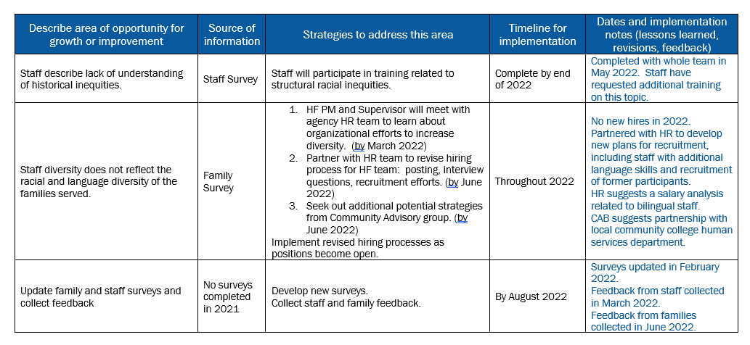
Equity Plan
Notes:
The Equity Plan needs to be separate and put into its own folder like the rest of the ASR information. Equity Plan should be updated to reflect anything you have done since you submitted this. Think about anything you have implemented and add to the plan to show the updates. Here is a sample equity plan that shows some updates.

Slide 9
Equity Plan
Notes:
Also, add any review information that you have completed. You should have discussed the equity plan with your advisory board and staff so add any feedback you received, any updates you made as a result. It's important to have at least feedback from staff in this section to score a 2. If you haven't reviewed the Equity Plan yet, do that and then add the feedback you received to the review table. If you are making adjustments to plan based on feedback, say that and you can also update the plan to reflect the changes based on feedback.

Slide 10
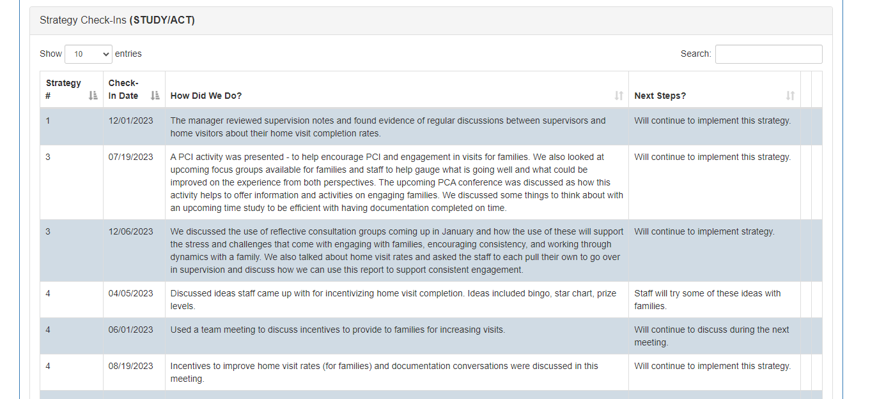
Continuous Quality Improvement Project
Notes:
CQI plans should also be updated to reflect any progress made. You can update it in MIS and then upload the updated CQI into your self study.

Slide 11
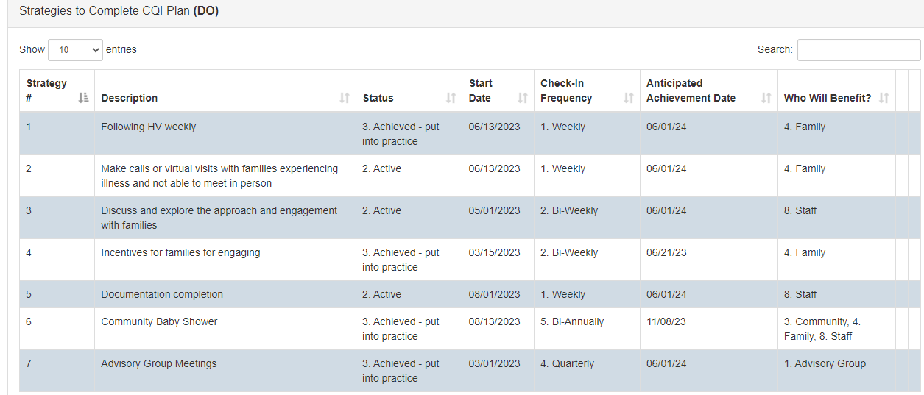
Continuous Quality Improvement Project
Notes:
Update progress

Slide 12
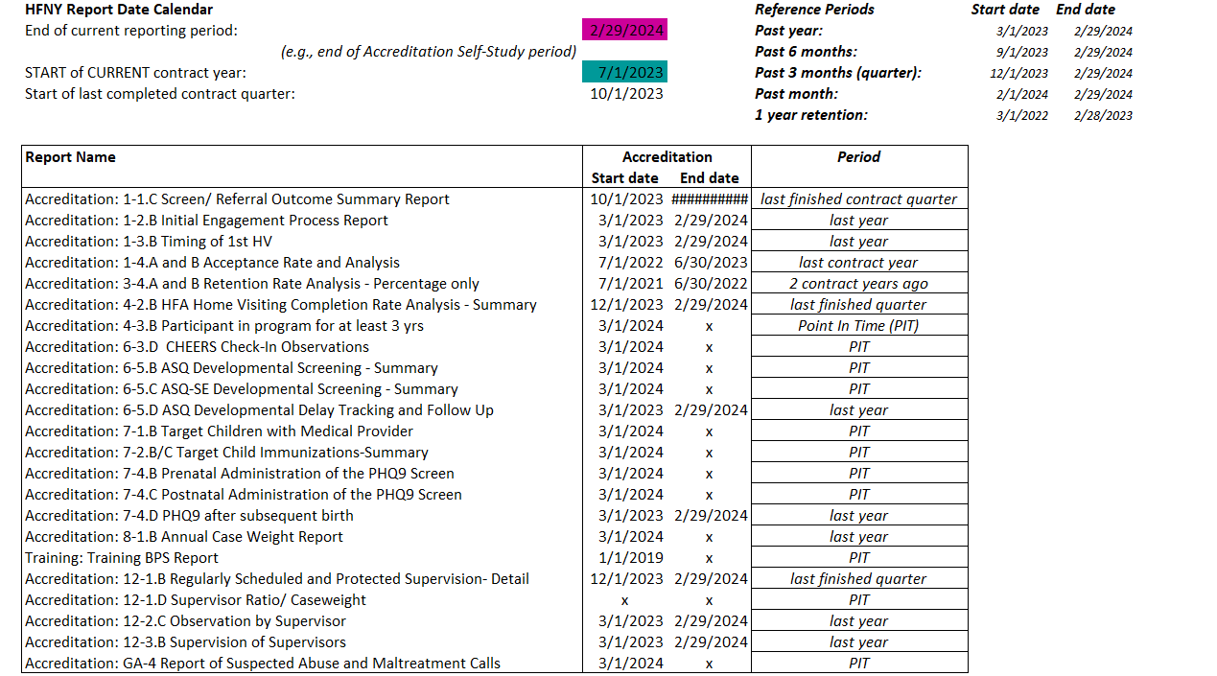
MIS Reports
Personalized Data Instructions for each site
Notes:
MIS reports and personalized Data Instructions for each site. We are working with CHSR to update the chart for MIS reports and have it personalized for each of you so you know the dates. Some reports you will just use what you have already run. For example, in talking with HFA it makes sense to leave your reports for the analysis and not re-run unless the report shows improved data from when you ran it last. If it has improved you should upload the new report to show improvement and will want to add an addendum under your original narrative to explain the improvement. However, other reports to show more recent practice will be run and we will guide you on those.

Slide 13
Submission to Peers
Link will be sent to the Program Managers for the HFA SharePoint
Download Self Study in HFNY Accreditation SharePoint and upload into HFA SharePoint
Notes:
You will receive a link from HFA to their SharePoint site. Once your self study is complete in the HFNY accreditation SharePoint, you can download the entire self study and then upload into the HFA SharePoint site. We can walk through in more detail how to do this if needed. NO EXTENSIONS CAN BE GRANTED SO PLAN AND BE PREPARED

Slide 14
Other To Do's Prior to the On-Site Visit

Slide 15
Surveys to Staff and Advisory Board
Notes:
About 8-12 weeks before your site visit, you will receive an email from HFA requesting a list of your staff and advisory board members and their email addresses. HFA will be sending a survey to staff and advisory board members. Here are some examples of survey questions

Slide 16
Prior to the Visit
Notes:
Prior to your visit you will be contacted by the peer team to discuss the travel logistics. They will want to know things like the closest airport, hotel options and rental car options. You may also want to think about putting together lunch recommendations for peers. They usually do working lunches and will need some options for takeout.

Slide 17
Prior to the Visit
Notes:
The peers will also work with you to discuss the agenda for the site visit. In the March meeting we will look at a sample agenda so you have an idea of the flow of the visit. File review is always the first day. Peers will need someone on site to walk them through the MIS which is where they will review most case records. Some paper documents may include signed consent forms or other paper forms that families sign that might not be in MIS. The peers will send you a draft agenda and then you will fill in the information for the interviews. If some interviewees are unable to be in person you can request zoom. Meeting rooms should be able to accommodate your staff at once. The peers will make adjustments to the schedule if needed.

Slide 18
Prior to the Visit
Notes:
The peers will review your self study leading up to the visit. They will reach out to you gather additional information if needed. This is a good opportunity to share additional evidence of practice to show adherence. Peers request additional info if they need more so they can give you opportunities to rate in. For example, during our CA visit they reached out about one of out orientation trainings missing two pieces. We updated the powerpoint and put it on the website and then sent it to them before they came on site and we were rated in. You can also create additional folders within the BPS folders to share additional evidence in the self study to show adherence. I did this for the QA visits we do. I uploaded all of our site visit reports so they had them before they even got to us.

Slide 19
Prior to the Visit
Notes:
The peer team will ask for the active caseload list. You can run MIS report for this information Active Participant Roster

Slide 20
Cost of Peer Review Travel
Peer expenses are calculated and invoiced as follows
The cost for a 3-day visit, the cost is $1750 per peer ($3500 total / 2 peers).
These flat rates include all peer expenses (i.e. airfare, hotel, ground transportation, and meals).
The National Office will invoice each site, after the site visit has been completed, for the peer fees.
Consider the budget year your visit is taking place.
Is it in the current contract period (23-24) or next contract year (24-25)?
Do you need to do a Budget Spending Adjustment
Notes:
All sites will have a 3 day visit. The cost will be $3500 total. This includes all expenses for the peers and you will be invoiced after your visit. Consider the budget year the visit is in and if you need to think about a BSA to cover the cost. Reach out to your PCM if you need to submit a BSA. The expenses should fall within the quarter the visit took place since that is when the expenditures were incurred.

Slide 21
What's Next?
In March we will discuss:
Sample Agenda
What to expect for reviews on site
Sample Interview Questions
Topics that may be part of interviews
Trends from HFA
Notes:
What's next! In march we will discuss and I will share what a sample agenda looks like, what to expect for the reviews on site and break down sample interview questions and topics that are considered for interviews. We will also discuss trends that HFA is seeing with site visits so you can be mindful and double check these things at your site.

Slide 22
QUESTIONS??

Slide 23
Questions on Self Study
For questions related to setting up an Outlook account to enable use of SharePoint, please reach out to Claudia Miranda-Julian.
Claudia.Miranda-Julian@ocfs.ny.gov
For questions related to interfacing with SharePoint and completing your self study, please reach out to your OCFS program contract manager.

Slide 24
Supporting Families
Right From the Start
Questions?
Allison.Contento@ocfs.ny.gov
Melanie.Schraa@ocfs.ny.gov
Suzan.Harry@ocfs.ny.gov

